Slide 1

337
Angular
Notes:
https://angular2-intro.firebaseapp.com/#/29
http://angularjs.blogspot.nl/2015/08/angular-1-and-angular-2-coexistence.html
http://larseidnes.com/2014/11/05/angularjs-the-bad-parts/
Example GITHUB → https://github.com/r-park/book-angular2-firebase
http://tryangular2.github.io/#/section-9/page-37

Slide 2




Peter Eijgermans
@EijgermansPeter

Slide 3
Agenda – 3 dagen
dag 1
Angular inleiding + CLI + Project Structure
Directives
Databinding
DI
Service and http, Observables
Components
dag 2
Routing
Exercise
Create an App with NativeScript + Angular
dag 3
Forms

Slide 4
GITHUB
https://github.com/petereijgermans11/workshop-angular7

Slide 5

Over jullie…

Slide 6
Voorkennis webdevelopment, (mobile/web-) apps?
Kennis AngularJS 1.x? Voorkennis andere (web)talen? Verwachtingen van de cursus?
Concrete projecten?

Slide 7
Globale werkwijze
Ik
Jullie
…

Slide 8


Slide 9
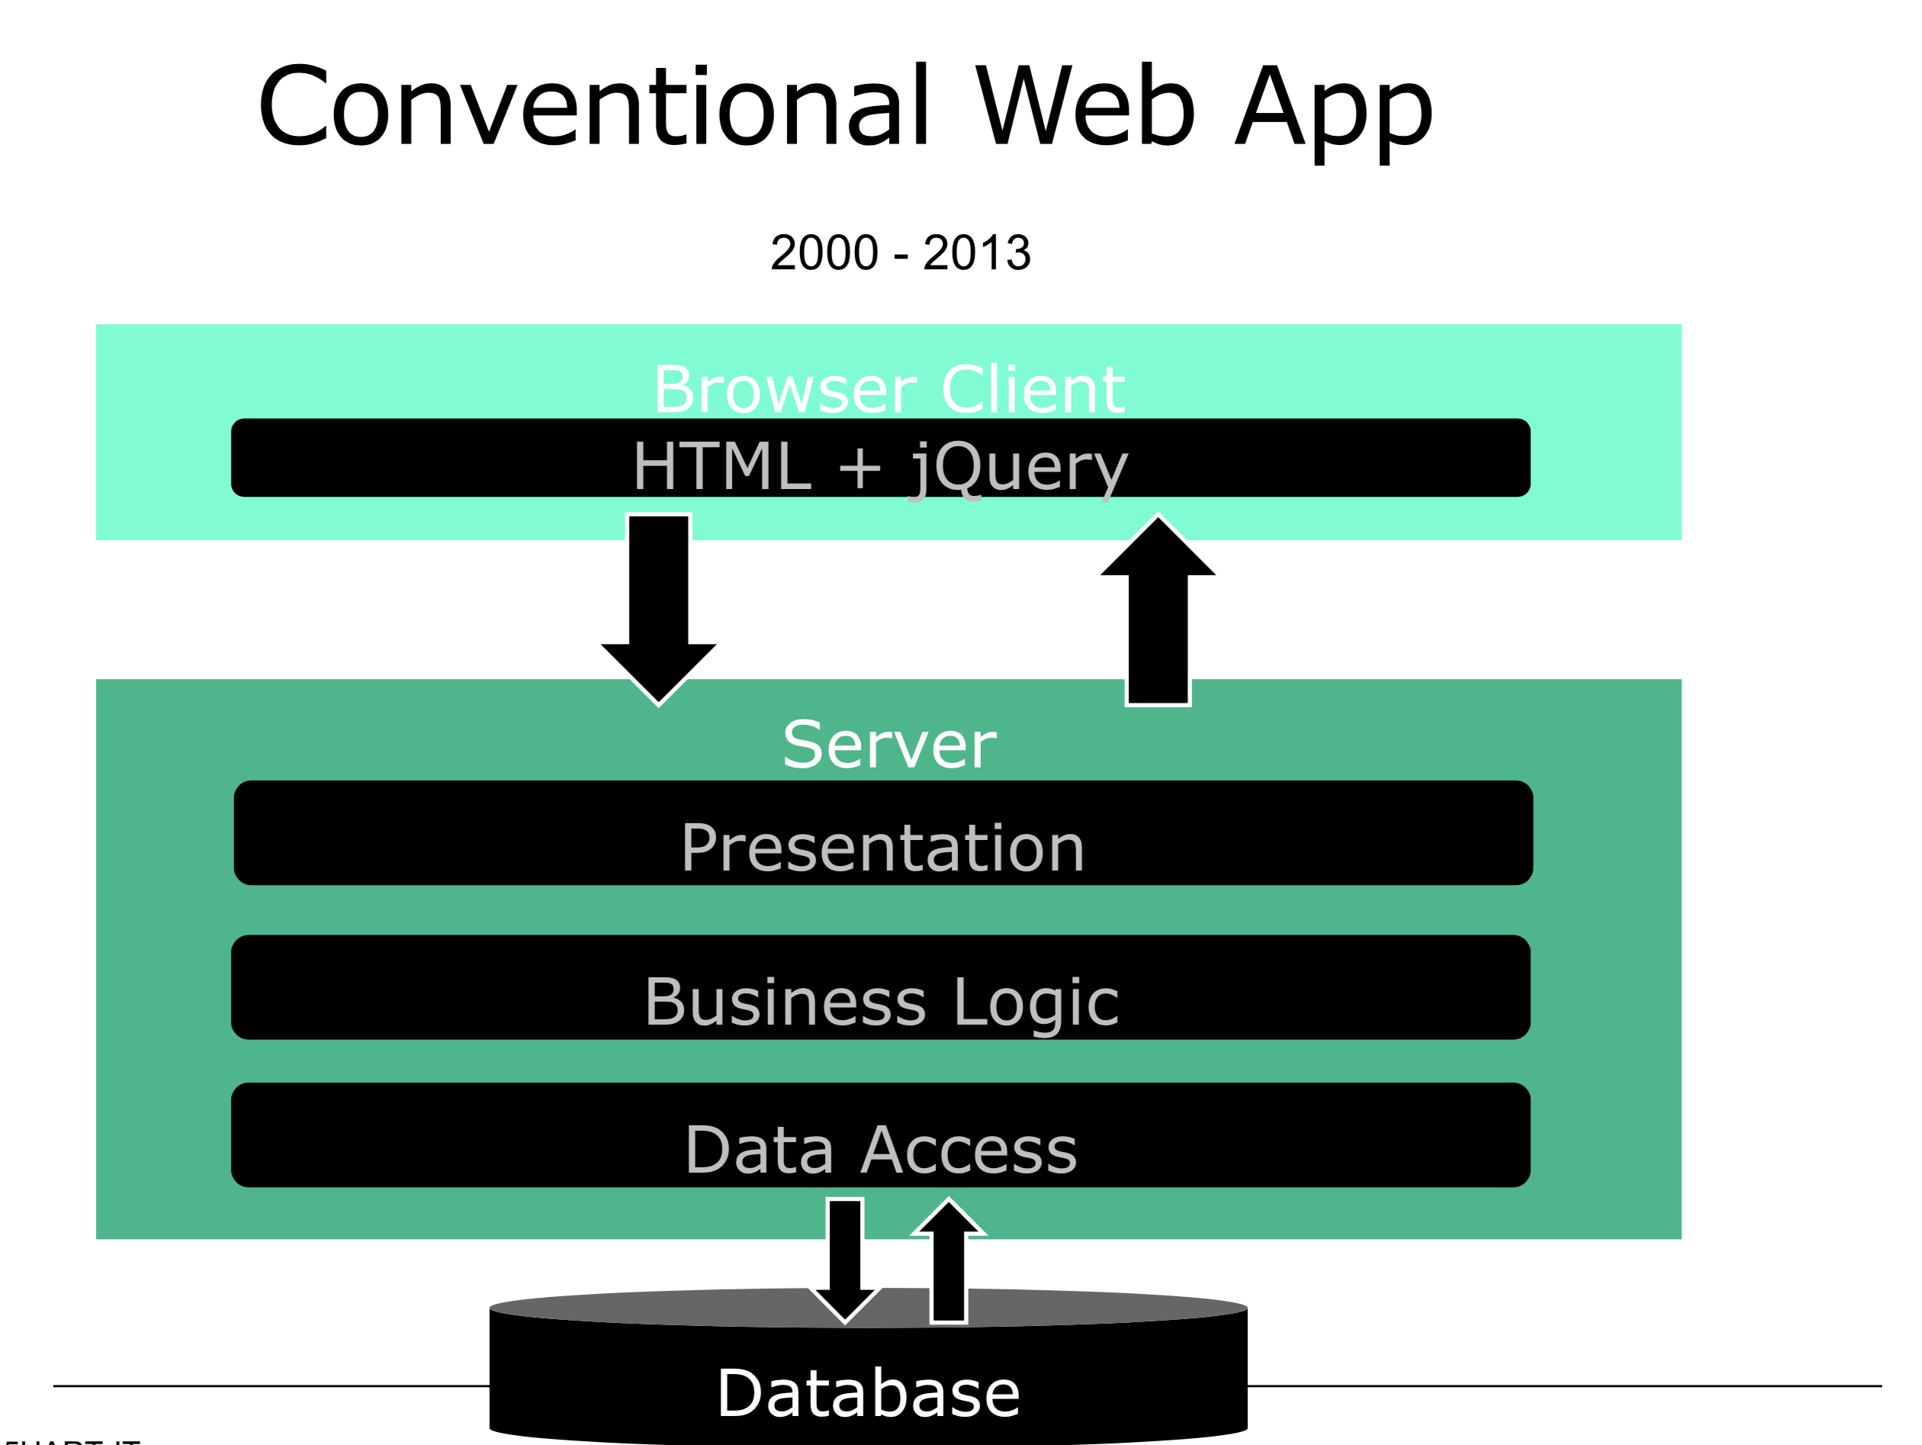

Slide 10
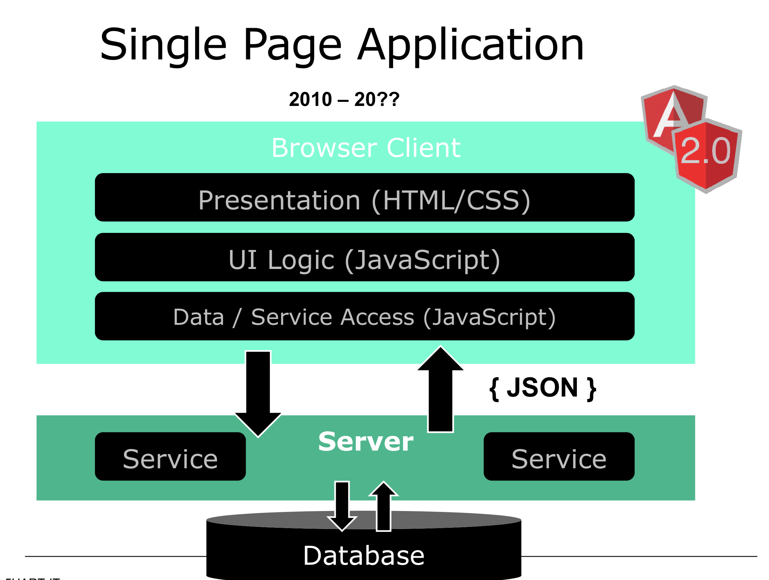

Slide 12




Slide 13
Angular characteristics
Community Speed
Simplicity & Consistency
Notes:
Snelheid rendering & performance

Slide 14
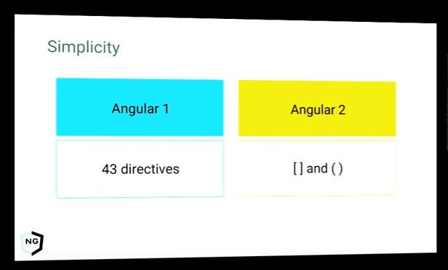
Consistency & simplicity
Consistente naamgeving & architectuur Consistente data binding

Slide 15
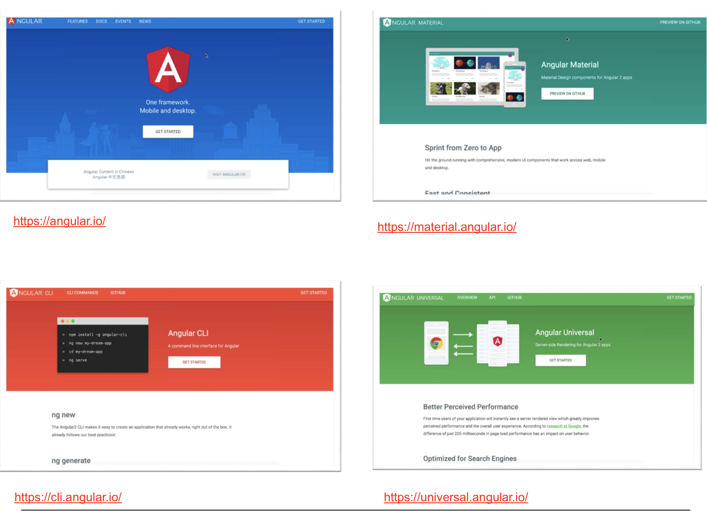

Slide 16
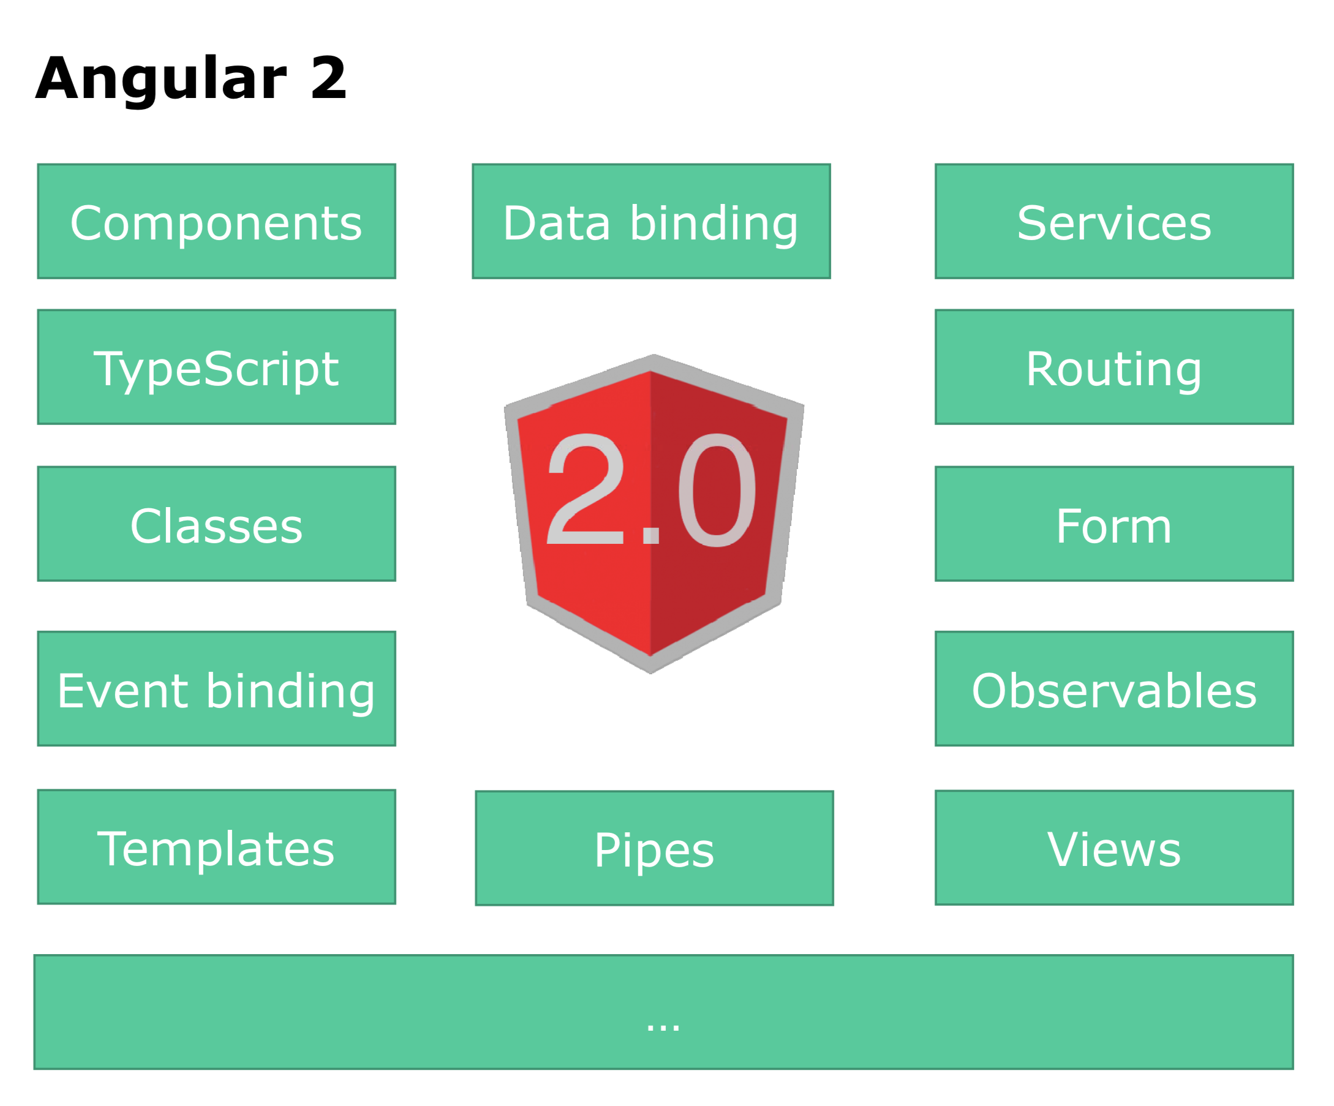

Slide 17
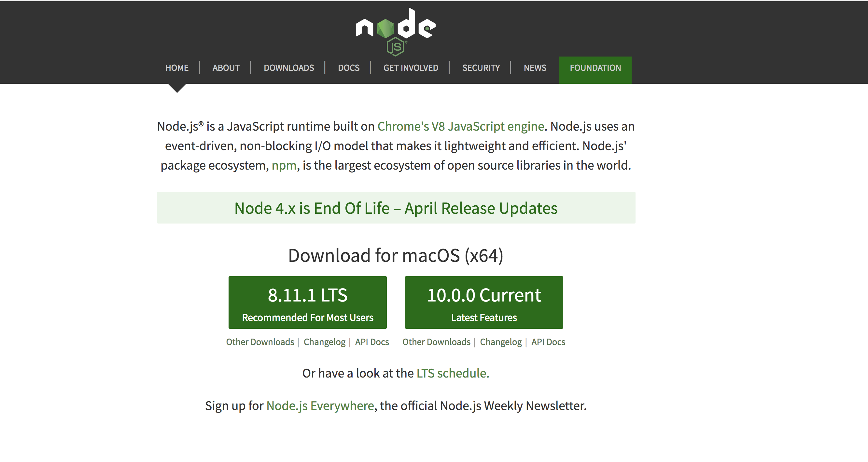
Install Node

Slide 18
IDE

Slide 19
Angular
TypeScript
Component based
DI
Efficient development
Notes:
TypeScript en Angular 2 gaan hand in hand. TypeScript is een typed superset van JavaScript
Component based → Is herbruikbare logica die je toevoegt aan je html-pagina.
Performance beter! → Betere/efficientere structuur: Angular 2 Apps zijn opgebouwd volgens een boomstructuur.
Geen $Scope → Geen gezamenlijk gebruik van de Scope. Componenten zijn niet meer gekoppeld aan elkaar middels $Scope.
DI – Wordt gebruik gemaakt van interfaces (niet van concrete implementaties)
IDE → refactoring + autocompletion + type error op compilatie en runtime nivo
http://www.technofattie.com/2014/03/21/five-guidelines-for-avoiding-scope-soup-in-angular.html
http://busypeoples.github.io/post/thinking-in-components-angular-js/
- Gezamenlijk gebruik van $scope door meerdere controllers → controller kunnen niet afzonderlijk getest worden.
Problemen met scope in controller:
Niet makkelijk te testen
Controller is gekoppeld aan $scope
Controller niet herbruikbaar
Controller moeilijk te onderhouden
Gezamenlijk gebruik van $scope door meerdere controllers
- Scope kan je niet migreren

Slide 20
TypeScript

Slide 21
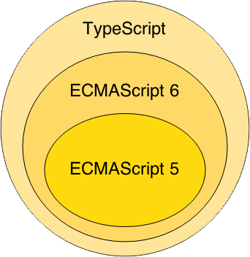
TypeScript
Notes:
Waarom TypeScript?
TypeScript is superset of ES6 en ES5.
ES = Standaard specificatie van JavaScript
ES6 = de nieuwste specificatie van Javascript, maar wordt nog niet ondersteund in alle browsers.
ES5 is de huidige standaard voor javascript en wordt ondersteund in de browsers.
TypeScript wordt vertaald naar ES5 (Middels een Transpiler).
TypeScript = Annotaties + Types + Interfaces + ES6
-----------------
TypeScript is van Microsoft.
Javascript is geschreven conform ES5

Slide 22


TypeScript = Annotaties + Types + Interfaces + ES6

Slide 23
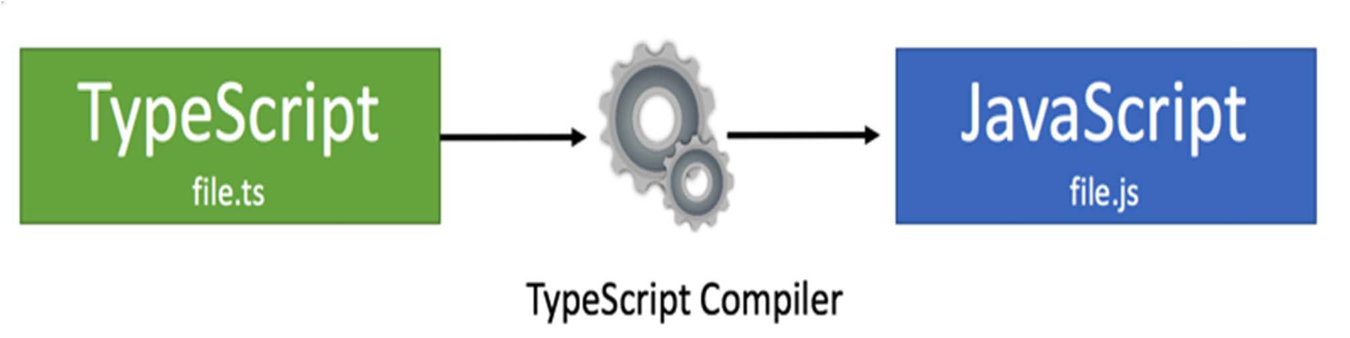
TypeScript Compilation
Zowel TypeScript als ES 6: compilatie nodig,
Huidige generatie browsers begrijpt ES6 en TypeScript niet.

Slide 24
TypeScript Class
class BookListComponent {
books: String[];
constructor() {
this.books =[‘book1’, ‘book2’]
}
}
Notes:
Example of a TypeScript class !!!
This refers to the class.

Slide 25
Components

Slide 26
Component based A component adds logic to DOM elements Angular app consist of a treestructuur of components
main.ts
AppModule
AppComponent
app.component.html
BookSearchComponent
DashBoardComponent
BooksComponent
BookDetalsComponent
Notes:
Angular is a tree of components, because it has the same structure as your html-structure !!!
Index.html is the parent template of AppComponent ect…
AppComponent is the parent of BookComponent and …
main.ts

Slide 27


Slide 28
Component based
SideBarComponent
AppModule
Module
AppComponent
BookSearchComponent
DashboardComponent
Notes:
Angular apps are composed of modules.
Modules exports classes, function, values — that other modules import.

Slide 29
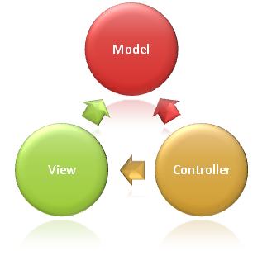
Syntax Component
import {Component} from ’@angular/core';
@Component({
selector: ‘book-list'
templateUrl: ‘booklist.template.html'
})
export class BookListComponent {
books: string[];
constructor() {
this.books =[‘book1’, ‘book2’]
}
}
Notes:
Structuur
This class is written in Typescript!
How to convert this class in a Component:
- You import the Typescript libraries from Angular ---> a Component is imported here
- You can now convert the class in a Component with the @Component annotation
- templateUrl - the address of this component's template
How does this work in action
With the selector you can instantiate and call the component
With the CSS selector you can tell Angular to create an instance of this component where it finds a <grocery-list> tag in parent HTML.
You export the Component class so that you can import and use it in the rest of your application.

Slide 30
Selector in index.html
….
<book-list></book-list>
….

Slide 31
Syntax template booklist.template.html
<p>Booklist: </p>
<ul>
<li *ng-for = “let book of books">
{{book}}
</li>
</ul>
Notes:
https://angular.io/docs/ts/latest/guide/template-syntax.html#!#star-template
*ng-for – Why?
The STAR Turns the li element and its contents into a template, and uses that template to instantiate a view for each item in list.

Slide 32
Module
SideBarComponent
AppModule
Module
AppComponent
BookSearchComponent
DashboardComponent
Notes:
Angular apps are composed of modules.
Modules exports classes, function, values — that other modules import.

Slide 33
AppModule
import {NgModule} from ‘@angular/core';
import {BrowserModule} from ‘@angular/platform-browser';
import {AppComponent} from ‘./app.component';
import {BookSearchComponent} from ‘../book-search/book-search.component';
import {DashboardComponent} from ‘../dashboard/dashboard.component';
@NgModule({
imports: [BrowserModule], // inject build-in modules
declarations: [AppComponent , BookSearchComponent, DashboardComponent], // inject your own components
bootstrap: [AppComponent] // main component you need to bootstrap
})
export class AppModule { }
Notes:
AppModule is the main entrypoint of your application = root module
@NgModule: Use @NgModule to Manage Dependencies in your Angular 2 Apps
Since we declared the BookListComponent in our root module, we can now use this BookListComponent anywhere in our application without needing to declare or import it again. In essence, the @NgModule handles dependency injection for us, so any component we declare will have the inherent knowledge of our other dependencies. We are not limited to declaring only components here, we could additionally write a directive or service, and declare use it the exact same way.
Imports: for importing build-in modules example BrowserModule for using: *ng-for
Declarations: for injecting your own components
Bootstrap: you need to bootstrap your main component
An‘umbrella’component(akaModule),holding all the dependencies that the Injector needs
• TypeScript annotation:@ngModule({...})
Inject other components
Inject Services/Providers
Bootstrap the Rootcomponent

Slide 34
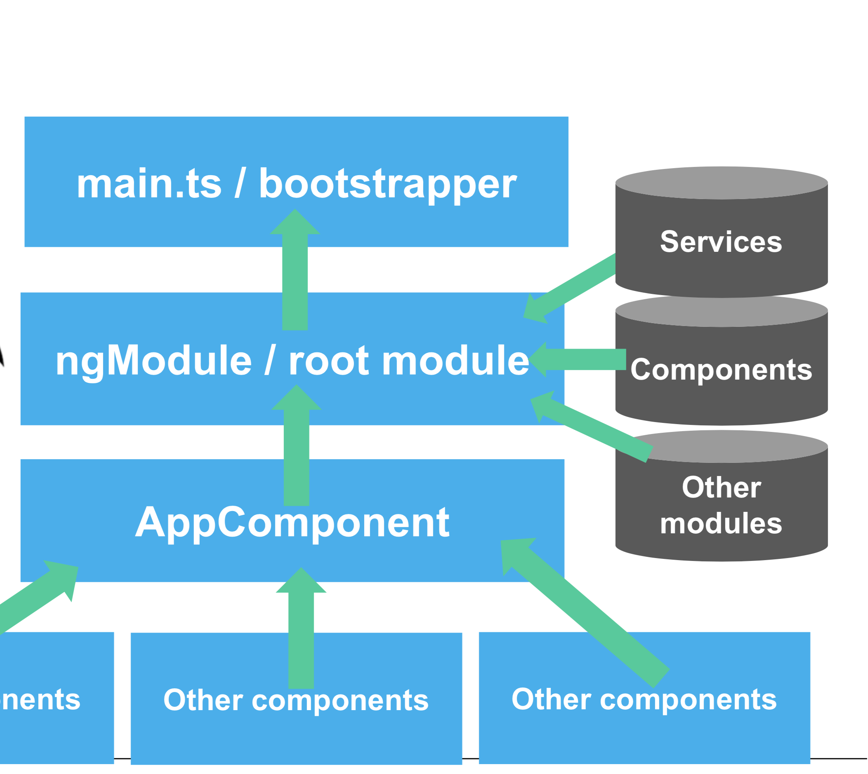

Slide 35
Angular CLI
Snel nieuwe projecten instellen via de command line

Slide 36
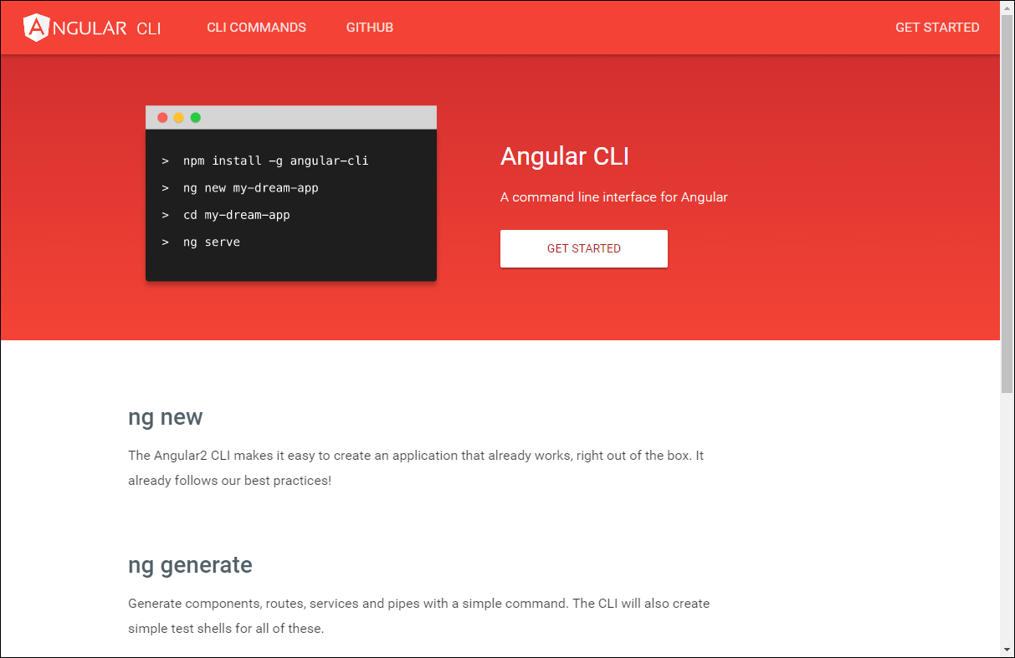

Slide 37
Install/Upgrade Angular CLI to 7
Install node (check: node -v)
Check your current version of Angular CLI:
ng –version
Uninstall the angular-cli package globally:
[sudo] npm uninstall -g angular-cli // For Mac
npm uninstall -g angular-cli // For Windows

Slide 38
Install/Upgrade Angular CLI to 7
Clear the cache
[sudo] npm cache verify
npm version is < 5. (npm --version)
npm cache clean
Install the Angular CLI
[sudo] npm install -g @angular/cli@latest
Notes:
If your version is still old, then try the following command:
-> ng update @angular/cli
check:
ng --version

Slide 39
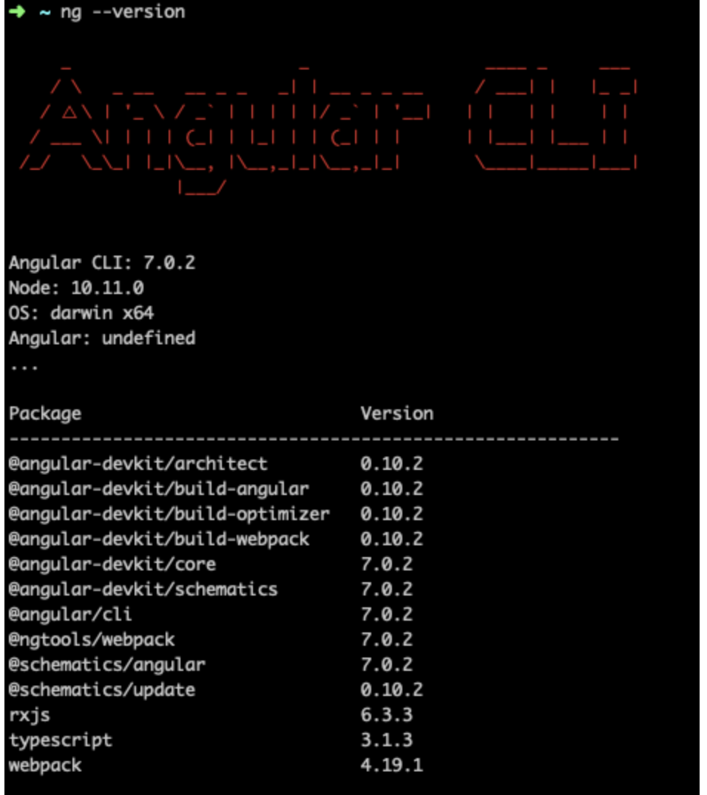
Check your Angular CLI version

Slide 40
Clear the cache
After updating both the global and local package, clear the cache to avoid errors:
npm cache verify (recommended)
npm cache clean (for older npm versions)

Slide 41
Update Angular Packages
ng update @angular/core
ng update rxjs

Slide 42
Scaffolding - Angular CLI
Notes:
Projecten, componenten, routes en meer definiëren vanaf de command line (CLI)

Slide 43
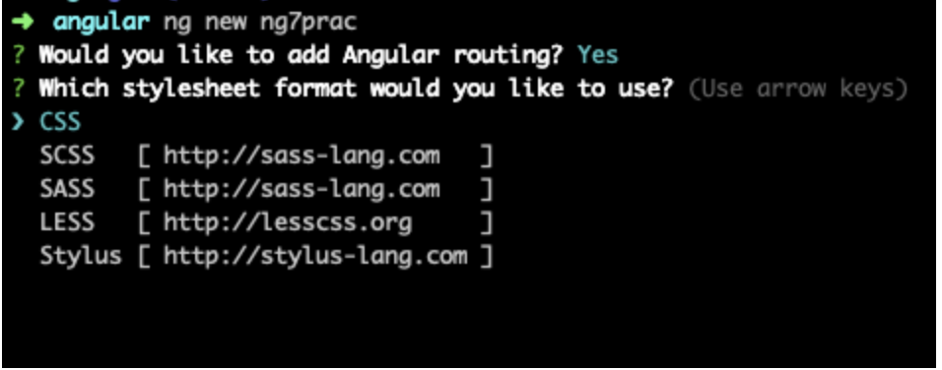
Generating an Angular project
ng new my-project
Notes:
The ng new command creates an Angular workspace folder and generates a new app skeleton.

Slide 44
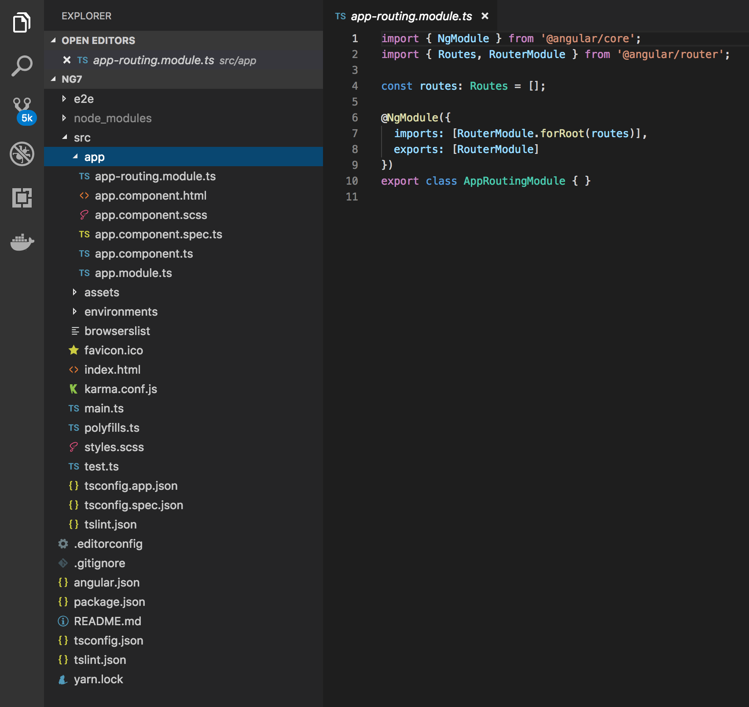
Notes:
A newly generated app contains the source files for a root module, with a root component and template. Each app has a src folder that contains the logic, data, and assets.

Slide 45
Generating and serving an Angular project
ng new my-project
cd my-project
ng serve
In your browser, open http://localhost:4200/
Notes:
The ng new command creates an Angular workspace folder and generates a new app skeleton.
ng serve → When you use the ng serve command to build an app and serve it locally, the server automatically rebuilds the app and reloads the page when you change any of the source files.

Slide 46
ng generate

Slide 47
ng generate
Use the ng generate command to:
generate new components
generate new services
Notes:
https://scotch.io/tutorials/use-the-angular-cli-for-faster-angular-2-projects

Slide 48
DEMO
Generate a new component in Hello World

Slide 49
Exercise
Go to folder: “Exercises Angular7”
and start the first exercise in: Oefeningen Angular.docx

Slide 50
ng generate exercise
https://medium.com/all-is-web/angular-5-creating-new-component-c6c5236f8024

